Slide 1
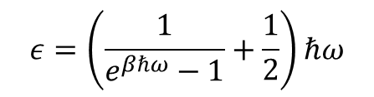
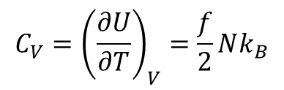

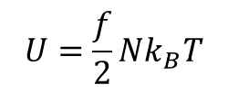
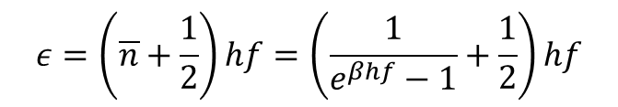
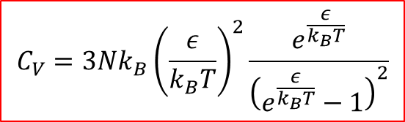
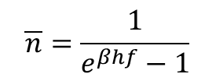


Theory of Solids
$$U=\frac{f}{2}Nk_{B}T$$
$$C_{V}={\left(\frac{∂U}{∂T}\right)}_{V}=\frac{f}{2}Nk_{B}$$
Classical model: Ideal gas model
Einstein Model:
Each atom in a solid crystal is treated as an independent 3-D harmonic oscillator
Each harmonic oscillator vibrates with frequency, f
For N atoms, there are 3N independent (distinguishable) oscillators
Distinguishable harmonic oscillator ➔ follows Bose-Einstein statistics with $μ=0$
$$\overline{n}=\frac{1}{e^{βhf}−1}$$
Planck’s distribution
Therefore, average occupancy,
$$ε=\left(\overline{n}+\frac{1}{2}\right)hf=\left(\frac{1}{e^{βhf}−1}+\frac{1}{2}\right)hf$$
Energy of each oscillator,
$$ε=\left(\frac{1}{e^{βℏω}−1}+\frac{1}{2}\right)ℏω$$
$$hf=ℏω$$
Total Energy of 3N harmonic oscillators,
$$U=3Nε$$
$C_{V}={\left(\frac{∂U}{∂T}\right)}_{V}=3N$ ${\left(\frac{∂ε}{∂T}\right)}_{V}=3N{\left(\frac{∂ε}{∂β}\right)}_{V}\left(\frac{∂β}{∂T}\right)$
$$C_{V}=3Nk_{B}{\left(\frac{ε}{k_{B}T}\right)}^{2}\frac{e^{\frac{ε}{k_{B}T}}}{{\left(e^{\frac{ε}{k_{B}T}}−1\right)}^{2}}$$

Slide 2



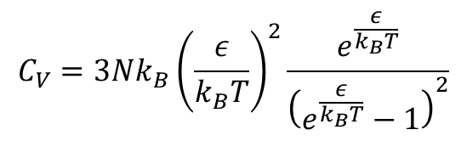
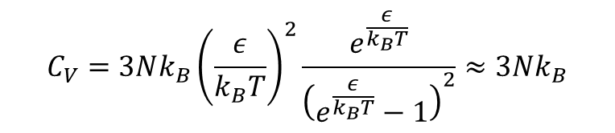
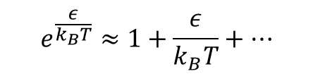


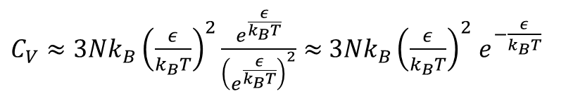
Theory of Solids cont.
$$C_{V}=3Nk_{B}{\left(\frac{ε}{k_{B}T}\right)}^{2}\frac{e^{\frac{ε}{k_{B}T}}}{{\left(e^{\frac{ε}{k_{B}T}}−1\right)}^{2}}$$
Einstein’s Model
For high T
➔ $e^{\frac{ε}{k_{B}T}}≪1$
$$k_{B}T≫ε$$
Taylor expansion
$$e^{\frac{ε}{k_{B}T}}≈1+\frac{ε}{k_{B}T}+⋯$$
$$C_{V}=3Nk_{B}{\left(\frac{ε}{k_{B}T}\right)}^{2}\frac{e^{\frac{ε}{k_{B}T}}}{{\left(e^{\frac{ε}{k_{B}T}}−1\right)}^{2}}≈3Nk_{B}$$
Independent of Temperature
Agrees with experimental data
For low T
$$k_{B}T≪ε$$
➔ $e^{\frac{ε}{k_{B}T}}≫1$
$C_{V}≈3Nk_{B}{\left(\frac{ε}{k_{B}T}\right)}^{2}\frac{e^{\frac{ε}{k_{B}T}}}{{\left(e^{\frac{ε}{k_{B}T}}\right)}^{2}}≈$ $3Nk_{B}{\left(\frac{ε}{k_{B}T}\right)}^{2}$ $e^{−\frac{ε}{k_{B}T}}$
Increases as Temperature increases
But experimental data shows $C_{V}∝T^{3}$
Failure of Einstein’s model
Reality is that atoms in a crystal do not vibrate independent of each other. There are modes of vibrations (oscillations)

Slide 3
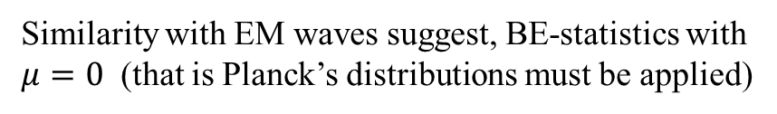

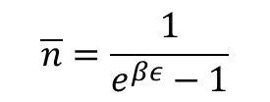
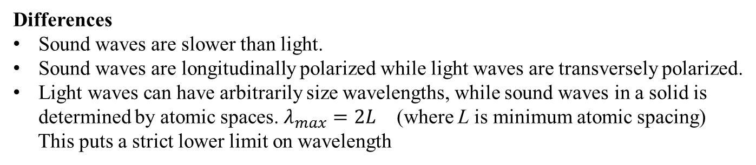

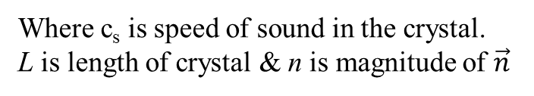

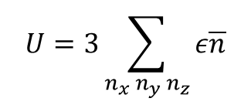
Theory of Solids cont.
Debye Model
The modes of oscillations in a solid crystal are, in many ways, similar to modes of EM field in vacuum.
Mechanical waves are called sound waves and behaves like light waves
Differences
Sound waves are slower than light.
Sound waves are longitudinally polarized while light waves are transversely polarized.
Light waves can have arbitrarily size wavelengths, while sound waves in a solid is determined by atomic spaces. $λ_{max}=2L$ (where L is minimum atomic spacing)
This puts a strict lower limit on wavelength
Energy of each oscillator, $ε=hf=\frac{hc_{s}}{λ_{n}}$
Standing waves ➔ $λ_{n}=\frac{2L}{n}$
Where c_{s} is speed of sound in the crystal.
L is length of crystal & n is magnitude of $\vec{n}$
➔ $ε=\frac{nhc_{s}}{2L}$
Similarity with EM waves suggest, BE-statistics with $μ=0$ (that is Planck’s distributions must be applied)
$$\overline{n}=\frac{1}{e^{βε}−1}$$
Total Energy of harmonic oscillators in 3-D,
$$U=3\sum_{n_{x} n_{y} n_{z}}{ε\overline{n}}$$

Slide 4
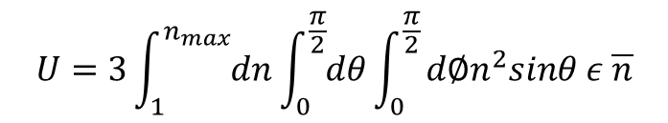
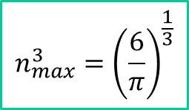
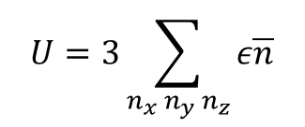



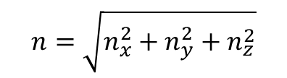
Debye Theory of Solids cont.
$$U=3\sum_{n_{x} n_{y} n_{z}}{ε\overline{n}}$$
For photons, there are infinite modes, but atomic spacing in a solid puts lower limit on wavelength (the minimum energy of sound waves is called phonons)
In 1-D each bump must at least contain one atom
Therefore, n cannot be more than number of atoms, N
In 3-D, consider a cube containing N atoms
Calculating sum is complicated
Debye’s idea was to pretend region in n-space
$$n=\sqrt{n_{x}^{2}+n_{y}^{2}+n_{z}^{2}}$$
➔ $\frac{1}{8}\left[V of sphere in n−space\right]=N$
➔ $\frac{1}{8}\frac{3}{4}πn_{max}^{3}=N$
$$n_{max}^{3}={\left(\frac{6}{π}\right)}^{\frac{1}{3}}$$
In spherical coordinates
$$U=3\int_{1}^{n_{max}}{dn}\int_{0}^{\frac{π}{2}}{dθ}\int_{0}^{\frac{π}{2}}{d∅n^{2}sinθ ε \overline{n}}$$
$$\overline{n}={\overline{n}}_{Pl}$$

Slide 5
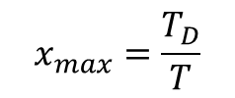
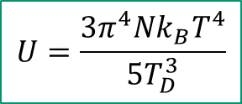
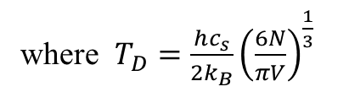
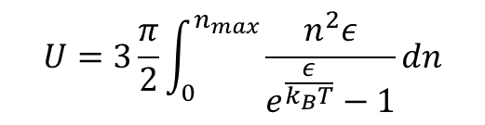
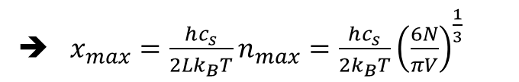
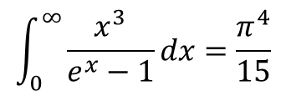

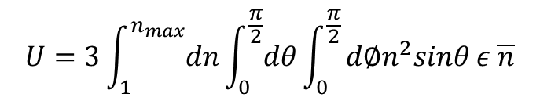


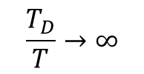
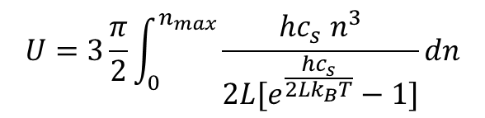
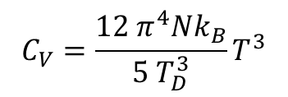


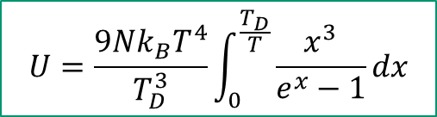

Debye Theory of Solids cont.
$$U=3\int_{1}^{n_{max}}{dn}\int_{0}^{\frac{π}{2}}{dθ}\int_{0}^{\frac{π}{2}}{d∅n^{2}sinθ ε \overline{n}}$$
$$U=3\frac{π}{2}\int_{0}^{n_{max}}{\frac{n^{2}ε}{e^{\frac{ε}{k_{B}T}}−1}dn}$$
0
Where $ε=\frac{nhc_{s}}{2L}$
$$U=3\frac{π}{2}\int_{0}^{n_{max}}{\frac{{hc_{s} n}^{3}}{{2L[e}^{\frac{hc_{s}}{{2Lk}_{B}T}}−1]}dn}$$
Assuming $x=\frac{hc_{s}n}{2Lk_{B}T}$
➔ $x_{max}=\frac{hc_{s}}{2Lk_{B}T}n_{max}=\frac{hc_{s}}{2k_{B}T}{\left(\frac{6N}{πV}\right)}^{\frac{1}{3}}$
$$U=\frac{9Nk_{B}T^{4}}{T_{D}^{3}}\int_{0}^{\frac{T_{D}}{T}}{\frac{x^{3}}{e^{x}−1}dx}$$
$$x_{max}=\frac{T_{D}}{T}$$
where $T_{D}=\frac{hc_{s}}{2k_{B}}{\left(\frac{6N}{πV}\right)}^{\frac{1}{3}}$
$$\frac{T_{D}}{T}→∞$$
$$\int_{0}^{∞}{\frac{x^{3}}{e^{x}−1}dx=\frac{π^{4}}{15}}$$
$$U=\frac{3π^{4}Nk_{B}T^{4}}{5T_{D}^{3}}$$
When $T≪T_{D}$
Low Temperature range
$$C_{V}=\frac{12 π^{4}Nk_{B}}{5{ T}_{D}^{3}}T^{3}$$
And $C_{V}={\left(\frac{∂U}{∂T}\right)}_{V}$
$$C_{V}∝T^{3}$$
In low Temp range
This agrees with experimental data
Heat capacity has contribution from electrons and lattice vibrations
$$C_{V}\left(T\right)=AT+BT^{3}$$

Slide 6
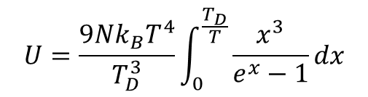

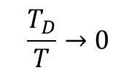












Debye Theory of Solids cont.
$$T≫T_{D}$$
$$\frac{T_{D}}{T}→0$$
What about high temperature range?
Since $x=\frac{n{hc}_{s}}{2Lk_{B}T}$
As $T→large, x→small$
$e^{x}≈1+x+⋯$ (Taylor expansion)
$\int_{0}^{\frac{T_{D}}{T}}{\frac{x^{3}}{e^{x}−1}dx≈}$ $\int_{0}^{\frac{T_{D}}{T}}{\frac{x^{3}}{x}dx}=\int_{0}^{\frac{T_{D}}{T}}{x^{2}dx=\frac{1}{3}{\left(\frac{T_{D}}{T}\right)}^{3}}$
Now
$$U=\frac{9Nk_{B}T^{4}}{T_{D}^{3}}\int_{0}^{\frac{T_{D}}{T}}{\frac{x^{3}}{e^{x}−1}dx}$$
$U=\frac{9Nk_{B}T^{4}}{T_{D}^{3}}$ $\frac{1}{3}{\left(\frac{T_{D}}{T}\right)}^{3}$
$$U=3Nk_{B}T$$
And $C_{V}={\left(\frac{∂U}{∂T}\right)}_{V}$
Independent of T in high temperature range
$$C_{V}=3Nk_{B}$$
In high temperature Debye model agrees with Einstein model
Low Temperature,
$$T≪T_{D}$$
High Temperature,
$$T≫T_{D}$$
Debye model of solid is in complete agreement with experimental data
$$C_{V}∝T^{3}$$
$C_{V}$is independent of T
Debye Temperature, T_{D} for
Lead 88 K
Diamond 1860 K

Slide 7




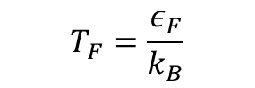
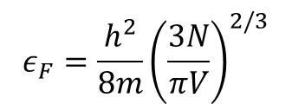
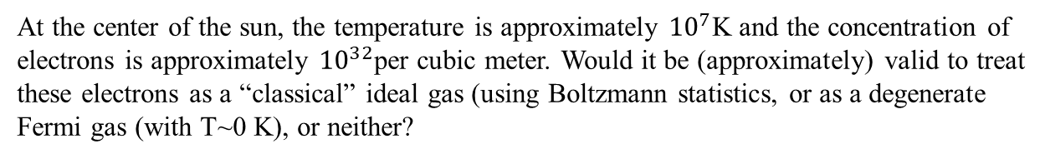

Problem 7.11
For a system of Fermions at room temperature, compute the probability of a single-particle state being occupied if its energy is
1 ev less the μ
0.01 eV less than μ
Equals to μ
0.01 eV greater than μ
1 eV greater than μ
Fermi-Dirac statistics
$$p=\frac{e^{−x}}{Z_{G}}$$
$$p=\frac{e^{−(ε−μ)/k_{B}^{}T}}{1+e^{−(ε−μ)/k_{B}^{}T}}=\frac{1}{e^{(ε−μ)/k_{B}^{}T}+1}$$
T =300 K
$$k_{B}=8.62×{10}^{−5}eV$$
$$Z_{G}$$
7.12 is similar problem, do it
7.13 is similar but Bosons, do it
Problem 7.20
At the center of the sun, the temperature is approximately ${10}^{7}$K and the concentration of electrons is approximately ${10}^{32}$per cubic meter. Would it be (approximately) valid to treat these electrons as a “classical” ideal gas (using Boltzmann statistics, or as a degenerate Fermi gas (with T~0 K), or neither?
$$ε_{F}=\frac{h^{2}}{8m}{\left(\frac{3N}{πV}\right)}^{2/3}$$
$$T_{F}=\frac{ε_{F}}{k_{B}}$$
Since $T_{F} \sim T$
We can not treat it either ordinary classical ideal gas (where T >> T_{F}) nor degenerate Fermi gas (where T << T_{F})

Slide 8
Problem 7.25
Problem 7.26
Problem 7.58

Slide 9
Chapter 7: Practice Problems
7.9, 7.11, 7.13, 7.20, 7.25, 7.26 (a, b), 7.44 (a), 7.45, 7.46 (a, b, c), and 7.58.
Assignment# 10
7.6, 7.14, 7.16, 7.18, and 7.19
Due Friday, 4/29/2022
Exam-3, Monday, May 2nd

